Slide 1
Plasticity Associated Changes in Cortical Somatosensory Evoked Potentials Following Spinal Cord Injury in Rats
Faith A. Bazley
Angelo H. All
Nitish V. Thakor
Anil Maybhate
Department of Biomedical Engineering
The Johns Hopkins University

Slide 2
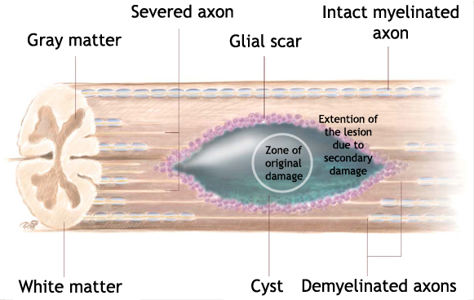
Background Spinal cord injury
Inflammation and migration of glial cells to the site of injury
formation of a glial scar
inhibition of axonal re-growth
Most human SCIs are incomplete
a number of anatomically intact but functionally compromised pathways remain
Loss of electrical signal conduction
disruption of neural pathways
damaged myelin
cavity formation
www.wingsforlife.com
Notes:
So just a little background on spinal cord injury
SCI causes a loss of electrical signal conduction through the site of injury
And this happens due to a number of reason
disruption of the neural pathways themselves
damage to the insulating myelin around the axons
and the formation of a cavity or a cyst at the site of injury
After the initial injury, secondary mechanisms of injury kick in that further damage the spinal cord
you have the migration of glial cells to the injury and then the formation of this glial scar that prevents any regenerating axons from regrowing across the lesion site to repair injury
And finally, complete transections are rare in humans
there remain a number of anatomically intact axons that span the site but that are functional compromised due to demyelination or scaring.

Slide 3
Background CNS Plasticity
Axonal sprouting
Formation of new spinal circuits
Cortical reorganization
Alterations in cell morphology and biochemistry
upregulation of neural progenitor cell (NPC) differentiation to promote neurogenesis or oligodendrogenesis.
Objective
“Identify cortical changes in response to forelimb sensory input after a thoracic SCI”
→ Utilize electrophysiology
→ Clinically relevant spinal contusion model
→ Afferent sensory pathways
“The adult CNS is known to be capable of significant functional reorganization in order to adapt to a changing environment or to a change in the CNS, for example after trauma”
(Raineteau, 2008)
Notes:
However, it is now recognized that the CNS is capable of significant functional reorganization in order to adapt to things like trauma, and this kind of what encompasses the idea of CNS plasticity
Plasticity has been described in many ways, a few of these being
…
Astrocytes begin to express markers, like nestin, characteristic of NPCs after injury

Slide 4
Approach Somatosensory Evoked Potentials (SEPs)
Quantitative way to assess the functional integrity of afferent sensory pathways
Used in clinical evaluations and in the operating room
Used to quantify the amount of injury or spared function of pathways after SCI
Monitor plastic changes or compensatory mechanisms in spared pathways

Slide 5
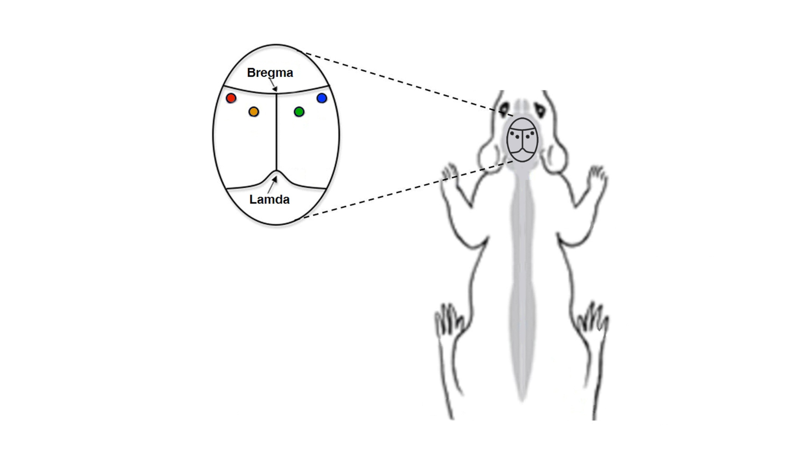
Methods SSEP monitoring setup
Experimental groups
6.25 mm contusion
12.5 mm contusion
Laminectomy control
*
REF
Lambda
T8
Implanted head-stage with four screw electrodes placed at the coordinates corresponding the hindlimb and forelimb regions of the S1
Notes:
Our experimental design consisted of three experimental groups.
A 6.25 mm contusion injury, which represents a mild SCI
A 12.5 mm contusion injury group, representing a moderate SCI
and a Laminectomy control group for the lamina at T8 is removed to expose the dorsal surface of the spinal cord underneath, without opening the dura mater.
We implanted a head-stage into each rat such with screw electrodes placed at the coordinates corresponding to the forelimb and hindlimb regions of the primary somatosensory cortex.
So the two lateral electrodes are placed at the forelimb regions
and the two medial electrodes are at hindlimb regions
So our setup begins with a pulse generator that is sent to a shift register to sequentially stimulate each of the four limbs one at a time.
Then SEPs are recorded simulataneously from each of the cortical electrodes, sent to a preamplifier and a multiplexer to separate the four channels, the signals are sampled at 5 kHz and stored for data analysis
Why T8? T8 is thicker than surrounding regions of the rat spinal cord
Tibial nerves innervate at Lumbar regions; Forelimb innervation is well above this region
9.7
.1
1.6

Slide 6
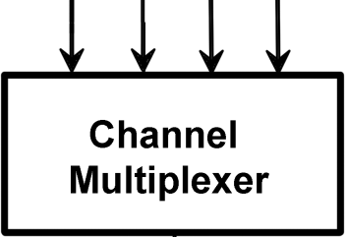
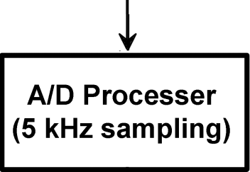
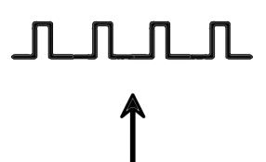
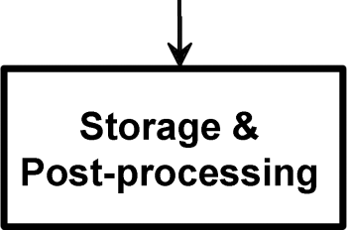
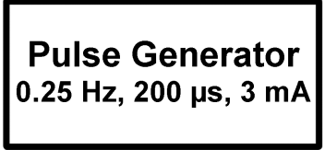
Methods SSEP monitoring setup
*
REF
Lambda
Notes:
First we implanted a head-stage into each rat such that screw electrodes made light contact with the cortex. The electrodes were implanted at the four regions of the cortex that correspond to the sensorimotor region for the four limbs
9.7
.1
1.6

Slide 7
Results Hindlimb stimulation scenario
Recording from
hindlimb region
Activation of sensory pathways
Activation of
hindlimb S1 cortex
Stimulation
Notes:
So the first thing we did was stimulate the hindlimb
This causes activation of the sensory pathways originating in the hindlimb region, which pass through the site of injury on the way to the brain
The signal arrives as the contralateral sensorimotor cortex corresponding to that hindlimb and activates this region.
Our implanted electrode picks up this signal in the form of the SEP

Slide 8
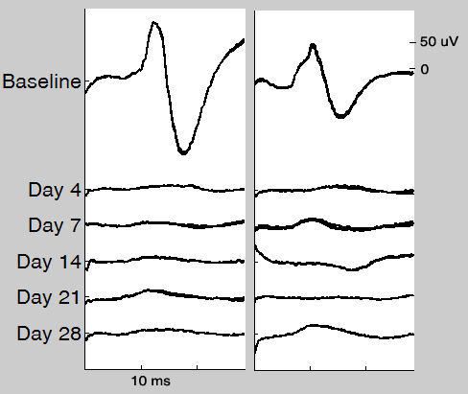
Results Reduced SSEP amplitude for hindlimb stimulation
RIGHT LEFT
Baseline SSEPs taken prior to injury
Nearly abolished at day 4 following injury
Partial recovery in the weeks post-injury
* p < 0.05, ** p < 0.01
Key point: Amplitudes of hindlimb SEPs decrease after injury.
Notes:
So this just shows representative results of SEPs recorded upon stimulation of the hindlimbs.
… click
Prior to injury, baseline recordings are taken for each limb and these serve as an internal reference point for each individual rat
You’ll notice at day after injury, the SEPs are nearly abolished, which is expected due to the injury to the somatosensory pathways between the point of stimulation in hindlimbs and the cortex.
Then in the weeks following SCI, there is a partial recovery
Here are just those results quantified for the three experimental groups. You can see the scenario again here on the right, where the hindlimb is stimulated to activate sensory pathways that travel through the site of injury to the hindlimb S1 cortex.
So let me just walk you through how the data is presented here…
For each individual rat, each of the SEPs after injury was normalized to that rat’s respective baseline SEP, which was taken prior to injury. So the results are always presented as a percent of baseline.
The values here are the means of each group on each day post-injury.
So if we take a look first at the control laminectomy group, you’ll notice that the SEP amplitude does not decrease.
However, for the two experimental groups receiving contusion injuries, the SEP amplitude decreases, and this grades with the severity of the injury, so the more severe injury shown in dark blue exhibited a more pronounced reduction in amplitude

Slide 9
Results Forelimb stimulation scenario
Recording from
forelimb region
Activation of sensory pathways
Activation of
forelimb S1 cortex
Stimulation
Notes:
The next thing we did was stimulate the forelimbs after spinal cord injury.
Now unlike the hindlimb pathways that pass through the site of injury, the sensory pathways of the forelimbs innervate the spinal cord rostral to the site of injury at T8 and are thus completely spared.
Again, the signals travel to the contralateral cortex and we recorded the activity from the electrode positioned at the forelimb region of the cortex.
So when we stimulated the hindlimb, we recorded from [this] electrode, but if you remember, the lateral electrodes are positioned at the forelimb somatosensory cortex so now we’re recording from this electrode

Slide 10
Results Increased SSEP amplitude for forelimb stimulation after injury
control:
no increase
increased
increased
Notes:
So what we found was that as early as day 4 after injury, the amplitude of these forelimb SEPs increased
And we observed this similar trend for both injury groups
And also that this result was sustained for the 4 weeks of our experiment
The green line just indicates that the latencies, or the time from stimulation to the first positive peak, remained unchanged

Slide 11
Results Increased SSEP amplitude for forelimb stimulation after injury
* p < 0.05, ** p < 0.01
Key point: Amplitudes of SEPs to forelimb stimulus increase after injury
Notes:
This figure shows these results quantified four our three experimental groups.
Again, the responses for each rat were normalized to the respective baseline SEP for the rat.
As you can see, both the mild 6.25 mm contusion and the moderate 12.5 mm contusion responded very similarly.
Even as soon as day 4 after injury, both groups showed a pronounced significant increase in the response to forelimb stimulation.
So what does this tell us?
- One possibility is that the forelimb representation in the cortex increases after an injury that partially denervates the hindlimb region.
It could also be hypothesized that the forelimb region expands following injury

Slide 12
Results Forelimb stimulation while recording from hindlimb cortex
Record from adjacent hindlimb region
Expanded forelimb representation?
Stimulation
Notes:
So the next question we asked was whether the forelimb region expands into the compromised hindlimb region.
To test this, we again stimulated the forelimbs as in the previous scenario
[click] However, if this region was to expand, then we should be able to pick up activity in the adjacent hindlimb region. So using our electrode placed at this region, we recorded the SEPs upon stimulation of the contralateral forelimb.

Slide 13
Results Forelimb stimulation while recording from hindlimb cortex
Key point: Enhanced SEPs can be recorded in the hindlimb region
during forelimb stimulus after injury

Slide 14
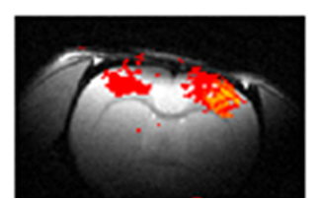
Results Signals travel from the contralateral to ipsilateral hemispheres
iF
cF
Record from ipsilateral hemisphere
Left forelimb stimulated
cF: contralateral forelimb region
iF: ipsilateral forelimb region
Notes:
So the final thing we have looked at was whether there exist intra-hemispheric changes following spinal cord injury
So using the same forelimb stimulation paradigm, in which the contralateral forelimb region is activated,
we also analyzed SEP signals from the hemisphere ipsilatateral to the stimulated limb.
Most surprsingly, we found that these ipsilateral signals actually emerged following spinal cord injury, where prior to injury the SEP was either very small or non-existent.

Slide 15
Conclusions
Summary
SEPs are an objective means to quantify longitudinal cortical changes in specific regions
Dramatic increase in the extent of forelimb cortical activation due to sensory input after moderate SCI
Hindlimb region becomes activated upon forelimb stimulation after injury
New ipsilateral activity upon forelimb stimulation emerges
Rapid adaptation within 4 days following injury

Slide 16
Conclusions
Conclusions
An increase in cortical forelimb representation post-injury
A partial expansion into the pre-injury hindlimb region
May occur via new spinal connections formed from partially intact hindlimb neurons above the site of injury; and/or a re-mapping of neurons in the cortex
CNS is capable of adaptation and reorganization early after injury
Future Directions
If and how these plastic responses relate to functional improvement and recovery?

Slide 17
References
Online image, http://www.wingsforlife.com/spinal_cord_injury.php?page=3
Olivier Raineteau, 2008 Plastic responses to spinal cord injury. Behavioural Brain Research 192 (2008) 114–123
A. Ghosh, et al., "Rewiring of hindlimb corticospinal neurons after spinal cord injury," Nature Neuroscience, vol. 13, pp. 97-104, 2009.
A. Ghosh, et al., "Functional and anatomical reorganization of the sensory-motor cortex after incomplete spinal cord injury in adult rats," Journal of Neuroscience, vol. 29, p. 12210, 2009.
Bareyre, et al. 2005. Transgenic labeling of the corticospinal tract for monitoring axonal responses to spinal cord injury
Fouad, et al. 2001. Cervical sprouting of corticospinal fibers after thoracic spinal cord injury accompanies shifts in evoked motor responsesG. Agrawal, et al., "Slope analysis of somatosensory evoked potentials in spinal cord injury for detecting contusion injury and focal demyelination," Journal of Clinical Neuroscience, vol. 17, pp. 1159-1164, 2010.

Slide 18
Acknowledgements
Angelo All, MD, MBA
Anil Maybhate, PhD
Nitish Thakor, PhD
Abhishek Rege, MSE
Charles Hu, BS
Siddharth Gupta, BS
Nikta Pashai, BS
David Sherman, PhD
IEEE-EMBS
Funding
Maryland Stem Cell Research Fund under Grants 2007 MSCRFII-0159-00 and 2009-MSCRFII-0091-00
Contact
Faith Bazley
faith@ieee.org

Slide 19
Results Areas observed
iF
cH
cF
Stimulation
During forelimb stimulation:
 | Contra | Ipsi
Forelimb
Hindlimb
1
3
2
Notes:
The next thing we did was stimulate the forelimbs after spinal cord injury.
Now unlike the hindlimb pathways that pass through the site of injury, the sensory pathways of the forelimbs innervate the spinal cord rostral to the site of injury at T8 and are thus completely spared.
Again, the signals travel to the contralateral cortex and we recorded the activity from the electrode positioned at the forelimb region of the cortex.

Slide 20
Supplementary Data
1. Contralateral forelimb sensory region
~ 11 ms
adjacent contralateral hindlimb sensory region
~ 12 ms
3. Ipsilateral forelimb sensory region
~ 16 ms
* p < 0.001

Slide 21
Supplementary Data
* p < 0.05, ** p < 0.01

